Slide 1
In partnership with the Government of Japan
Healthcare Data Protection – Policies, Protocols, and Practices
epihc.org

Slide 2
Speaker
Facilitator
Dr. Prinesh Reddy
Workshop Subject Matter Expert and Team
Dr. Brad Beira
Dr. Ureshnie Govender

Slide 3
Programme Overview
Delegate Welcome
IFC - YG
Introduction and workshop flow
PR
1
The fundamentals of data security in healthcare
2
Regulations and guidelines in the digital health ecosystem
3
The Operating Environment
4
Regulatory requirements for healthcare data
5
Guidelines and principles for data compliance and protection in operations
6
Practical applications and examples for health data security
Notes:
6 components - change to fundamental look and feel are linked…
Framing and Context…challenges in healthcare system: change in health eco-system as we digitise - shift in consultation as we digitise hence we need to create common language and to understand that language in order to create and implement resilient data protection systems

Slide 4
The key message of - The 3 important P’s
Safeguarding information & data security
The users of the platforms in the ecosystem.
The technology used in the ecosystem.
People
Process
Product
How the users interact in the ecosystem.

Slide 5
Medicine vs Health
Medicine vs Health
“Health is a state of complete physical, mental and social well-being and not merely the absence of disease and infirmity” - Alma Ata declaration – WHO
“Medicine refers to the field of study and practice focused on diagnosing, treating, and preventing diseases and ailments in individuals” - WHO
How do we define a consultation?
Can a virtual consultation be part of value-based care?
Is Telehealth person centric interoperable care?
Notes:
Set the scene….The world is changing swiftly in terms of Care at rural and hands level….interconnectedness to think global and deliver local….challenge of virtual consultation….risks of virtual consultations in a person centred inter-operable space….is this person centric and inter-operable between clinicians and centres? Talk to Liability: standards, protection of data…next move into fundamentals and 3 key insights

Slide 6
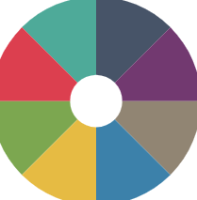
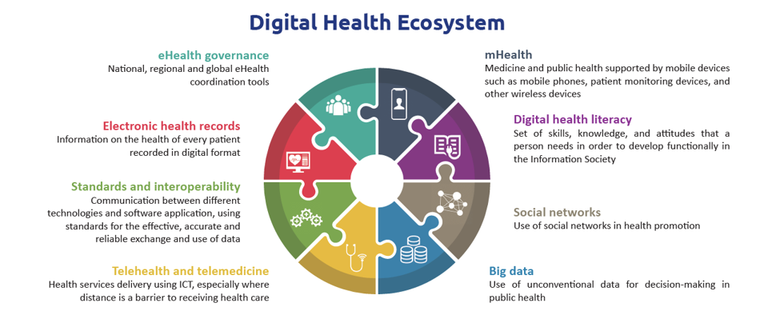
The digital health ecosystem
The therapeutic world we now live in
WHO
Notes:
Journey of the Digital Health Ecosystem View….of the Therapeutic World we live in….key elements that require understanding to create an interoperable digital health ecosystem to enable safe and secure exchange of health data by and between users. Health data are predominantly generated by and processed between health care providers and the health care community
Presentation addresses key issues around cyber and security - go around the ecosystem discussion around cybersecurity and
Image Principles on the respectful handling of data: critical to understand the this basics of this ecosystem and how best to manage and protect personal data
We are use this image to navigate through the next key components that need to be considered in the therapeutic world we live in, the first being Health data.
Understanding what personal data means is critical and thereafter how this personal data is acquired, managed, disposed of and communicated fits in into an understanding of the Digital Health Ecosystem.
Principles on the respectful handling of data

Slide 7
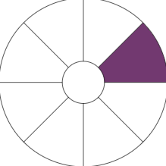
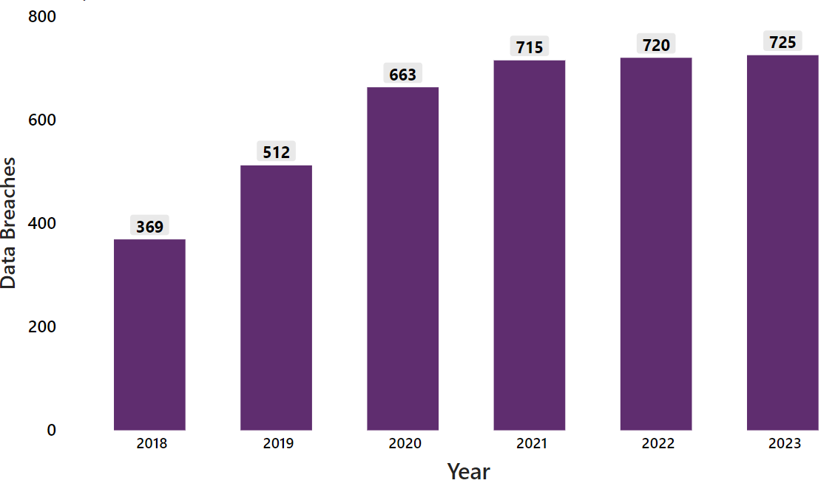
Healthcare data breaches
“threats to healthcare organisations are steadily growing”
- Forbes, 2021
More systems
Valuable
Expensive management
Healthcare security data breaches
of 500+ records (2018-2023)
Biggest Healthcare Security Breaches in 2023
Entity | Source of threats | People affected | Cause of Data Breach
Healthcare Provider | *BA | ~11.3m | Network access - hackers
Perry Johnson & Associates | *BA | ~9m | Network access - hackers
Managed care of North America | *BA | ~8.9m | Ransomware
Welltok, In.c | *BA | ~8.5m | Network access - hackers
PharMerica Corporation | Provider | ~5.8m | Ransomware
HIPAA: 2023 Healthcare Data Breach Report
*BA - Business Associate (e.g.Microsoft, Telehealth platforms , Cloud providers - AWS, Azure)
Notes:
Remember the 3 p’s: People affected: source of vulnerability is internal staff…lack of skilled individual, lack of consistency with maturity assessment…

Slide 8
Cyber-security preparedness based on breaches and threats
Case Study 1 - Multinational health insurance and services company
Case Study 2 - Non-profit healthcare provider
Ransomware attack in 2024. The impact on company earnings is estimated to be approximately $900 million.
Ransomware attack in 2021: Cost $112M in lost revenue and fines.
Case Study 3 - Personal genomics and biotechnology company
Case Study 4 - University medical centre
Ransomware attack in 2024. Approximately 7 million user profiles were compromised with significant brand and reputational damage.
Ransomware attack in 2021: Total financial costs of approximately $65 million. Cancer care impact was approximately $30 million.
Notes:
https://www.cbsnews.com/news/unitedhealth-senate-hearing-cyberattack-change-healthcare/
Case Study 2

Slide 9
1
The fundamentals of data security in healthcare
2
Regulations and guidelines in the Digital Health Ecosystem
Introduction The importance of protecting healthcare data Definitions Defining personal data according to different geographies Self Assessment Introduction of different self-assessment and it’s importance Interactive session for audience feedback on their experiences with assessing maturity
3
The operating environment
4
Regulatory requirements for healthcare data
5
Guidelines and principles for data compliance and protection in operations
6
Practical applications and examples for health data security

Slide 10
Cybersecurity
“Cyber threats to healthcare organisations are steadily growing” - Forbes, 2021
Cyber-resiliency
“the ability to anticipate, withstand, recover from, and adapt to adverse conditions, stresses, attacks, or compromises on systems that use or are enabled by cyber resources”
National Institute of Standards and Technology (NIST)
Small
Medium
Large
Increasingly targeted
Greater capacity for cyber resistance
Underestimating the risk
Lack of skills and knowledge
Lack of resources
Rapid pace of technology advancement
Conflicting / excessive cyber security information
Lack of perseverance
Notes:
SME are Increasingly targeted by online threats because they are perceived as being inherently more vulnerable.

Slide 11
Definitions of personal data
General Data Protection Regulation (GDPR)
“Any information relating to an identified or identifiable natural person. Identifier such as a name, an identification number, location data, an online identifier or to one or more factors specific to the physical, physiological, genetic, mental, economic, cultural or social identity of that natural person” - Article. 4 GDPR, (1)
Health Insurance Portability and Accountability Act (HIPAA)
“Referred to as Protected Health Information (PHI). An individual’s health, treatment, and payment information, and any further information maintained in the same designated record set that could identify the individual or be used with other information in the record set to identify the individual” - Sections 261 to 264
Notes:
GDPR
GDPR Articels
GDPR - WHO, Microsoft, PwC, Technology
HIPAA, PHI, HIPAA Privacy Rule -
Setting the scene and ensuring that everybody is on equal footing irrespective of location
HIPAA - North Ameria

Slide 12
Definitions of personal data
Protection of Personal Information Act (POPIA)
“Information relating to an Identifiable, living, Natural person, and where it is applicable, an identifiable, existing juristic person. Including but not limited to:
Race, gender, sex, pregnancy, marital status, national, ethnic or social origin, colour, sexual orientation, age, physical or mental health, well-being, disability, religion, conscience, belief, culture, language, birth;
Education or the medical, financial, criminal, employment history;
Identifying number, symbol, e-mail address, physical address, telephone number, location information,
Online identifier, biometric information,
Personal opinions, views or preferences
POPI Act 2013, Chapter 1, Section 1
Other: PIPEDA (Canada), DPBI (India)
Notes:
POPI Act , POPI Definitions , Personal Information Protection and Electronic Documents

Slide 13
Self assessment - Different frameworks for different functions
Assessment Type | Process measurement: IT process governance | Information security: Regulatory compliance and risk management | Process measurement: Software development, acquisition & maintenance | Cybersecurity: Management guidelines
Maturity Model Name | COBIT 2019 | HITRUST | CMMI | NIST-CSF
Applicability | SMEs: COBIT for Small and Medium Enterprises | Highly adopted in healthcare. Designed for scalable but can be difficult for smaller organisations (~$36 000) | SMEs: Comprehensive but applicable for SMEs. Challenges with affordability & expert need when implementing | SMEs: NIST Interagency Report (NISTIR)
 | Large organisations: COBIT 2019 |  |  | Large organisations: NIST-CSF
Level description | 5-Level model Non-existent Initial/ad hoc Repeatable but intuitive Defined process Managed & measurable Optimized | 4-Level model Basic Aspirational Developing Integrated | 5-Level model Incomplete Initial Managed Defined Quantitatively managed Optimised | 4-tier model Partial Risk informed Repeatable Adaptive
Well described
Trained
Regular
Consistent
Notes:
Cybersecurity maturity: is a measure of the ability of a utility to protect its assets from harm…resilience of one’s organisation as it relates to digitisation
Consistent observation that most enterprises adopt cloud technologies and services without proper evaluation due to the limited knowledge of existing security evaluating tools and methodologies.
Comparing maturity with maturity. If you rated yourself a four on one scale that may be high on your list but low in my list. Ensure that comparison is along the same scale.
Customized Approaches: In emerging economies, organizations often adapt existing models or create customized frameworks based on their specific context and resources
HITRUST
Required by all major healthcare payers in the US
The HITRUST CSF normalises security and privacy requirements for organisations, including HIPAA
Based on ISO/IEC 27001 & 27002
Complexity in Application:
The CMMI Cybermaturity Platform aims to simplify security gap analysis and provide actionable insights. Its complexity depends on an organization’s existing cybersecurity practices and readiness for improvement.
NIST
The NIST CSF allows organizations to tailor their cybersecurity efforts according to their risk tolerance, business context, and available resources. It recognizes that one size does not fit all and encourages flexibility.
NIST CSF does not prescribe specific maturity levels. Instead, it offers a set of functions, categories, and subcategories that organizations can customize based on their unique needs.

Slide 14
Engagement session
Which cybersecurity maturity framework do you (or would you) use and why?
If you don’t have a maturity framework , give a rough estimation of how mature you think you may be?
Incomplete
Standardised
Optimised

Slide 15
1
The fundamentals of data security in healthcare
2
Governance The transition of data governance over different regions The importance of an enabling environment Cyber-resilience resources Cyber-resilience resources Cyber-resilience is different sized organisations Interactive session for audience feedback on their experiences with assessing cybersecurity maturity
Regulations and guidelines in the Digital Health Ecosystem
3
The operating environment
4
Regulatory requirements for healthcare data
5
Guidelines and principles for data compliance and protection in operations
6
Practical applications and examples for health data security

Slide 16
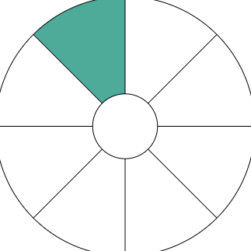
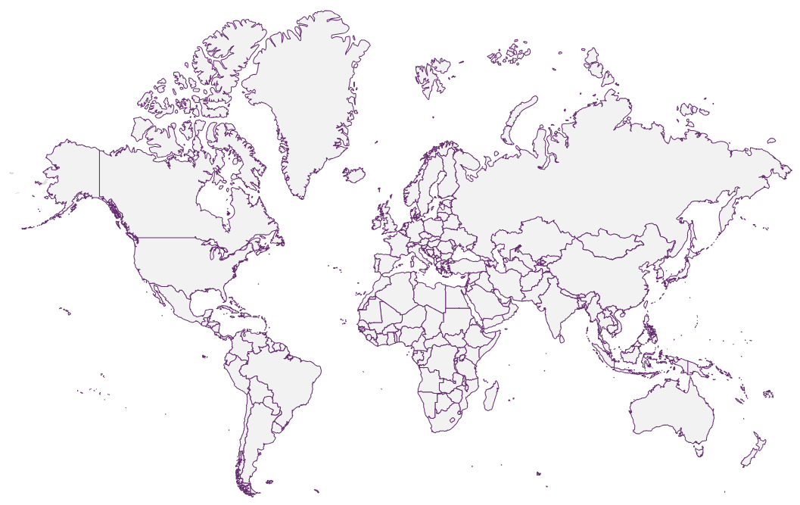
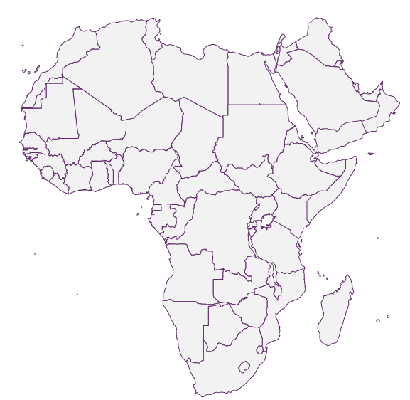
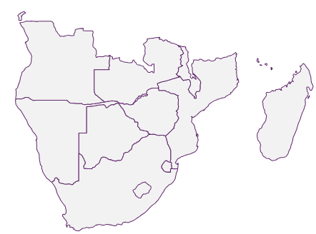
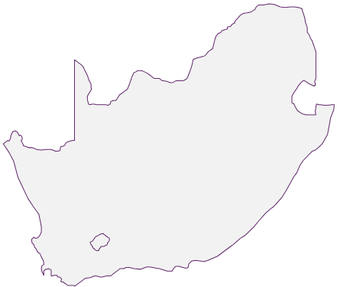
The legal landscape and eHealth governance
Non-exhaustive list
World Health Organisation (WHO), NIST Cybersecurity Framework
Google
Amazon Web Services (AWS)
Apple
Microsoft cybersecurity policy framework
Global
Continental
Africa Agenda for Cyber Capacity Building
Computer Fraud and Abuse Act (USA)
EU Cybersecurity
European Union Agency for Cybersecurity - EU
Regional
[Text]
General Data Protection Regulation (GDPR) - EU
EU Cybersecurity Act - EU
African Union Convention on Cybersecurity and Personal Data Protection
CyberBRICS
Neighbouring
[Text]
Most important
Local National Cybersecurity Policy Framework
HIPAA (USA), PIPEDA (CAN), POPI (RSA)
Essential Eight (AUS)
21st Century Cures Act (USA)
[Text]
Domestic
Notes:
To create this system, one requires an understanding of the legal landscape…the domestic policies and international that guide governance …..managing risks, harm, breach….mutliple parts and multiple players….awareness of what you are guided by….operating domestic or global…risks and harm abd breaches potential grows as you operate more globally…mitigate being comporimiesed

Slide 17
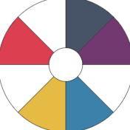
EHR, Telemedicine and mHealth environment
Enabling Environment
Non-exhaustive
Varied Data Protection Acts/Bills, Ministries of Health
Patient Data
Privacy
Security
Domestic
Regional
Global
LGPD
POPIA
African Union
Global Data Alliance (GDA)
HIPAA
Federal Law No 2 of 2019
APEC-CBPR
WHO
GDPR
APPI
Global Alliance for Genomics and Health
Notes:
The important of the enabling environment
Data: What happens when you have medical tourism - Who’s territory standard do we use - Jurisdiction consideration of record ownership as well as record keeping, liability questions (If I consult with a patient in country X what happens)
References
Brazil, LGPD and GDPR
Brazil regulation
UAE
African Union Convention on Cybersecurity and Personal Data Protection
POPIA
APEC Cross-Border Privacy Rules (CBPR)
Global data alliance
Global Alliance for Genomics and Health (GA4GE)
mApps in Africa
Data Sharing in Africa
Act on the Protection of Personal Information (APPI) - Japan

Slide 18
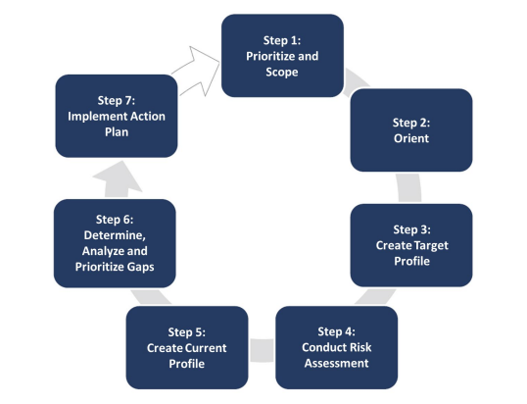
Cybersecurity resilience resources
Healthcare Sector Cybersecurity Framework Implementation Guide - HICP
The Framework for Improving Critical Infrastructure Cybersecurity Framework - NIST
Significant Progress Made
Email protection systems
Urgent Improvement Needed
Endpoint Protection Systems Identity and Access Management Network Management Vulnerability Management Security Operation Center and Incident Response
Further Attention Required (Not Urgent)
Data Protection and Loss Prevention
Additional Research Required
IT Asset Management Network Connected Medical Device Security Cybersecurity Oversight & Governance
Notes:
Hospital Cyber Resiliency Landscape Analysis, 2023, Maturity Model for healthcare organisations, 2021 , NIST Cyber security Framework
HICP
Email Protection Systems: Implement systems to filter out potential phishing emails and other malicious content.
Endpoint Protection Systems: Use security software to protect network endpoints from malware and other threats.
Access Management: Ensure only authorized individuals have access to sensitive data and systems.
Data Protection and Loss Prevention: Implement measures to protect data and prevent data loss.
Asset Management: Keep track of all hardware and software assets.
Network Management: Monitor and control activities on your network.
Vulnerability Management: Regularly scan for and patch vulnerabilities in your systems.
Incident Response: Have a plan in place to respond to security incidents.
Medical Device Security: Ensure the protection of network-connected medical devices.
Cybersecurity Policies: Develop and enforce robust cybersecurity policies.
NIST - The Cybersecurity Framework can be used to compare an organization’s current cybersecurity activities with those outlined in the Framework Core. Through the creation of a Current Profile, organizations can examine the extent to which they are achieving the outcomes described in the Core Categories and Subcategories, aligned with the five high-level Functions: Identify, Protect, Detect, Respond, and Recover. An organization may find that it is already achieving the desired outcomes, thus managing cybersecurity commensurate with the known risk. Alternatively, an organization may determine that it has opportunities to (or needs to) improve. The organization can use that information to develop an action plan to strengthen existing cybersecurity practices and reduce cybersecurity risk. An organization may also find that it is overinvesting to achieve certain outcomes and use this information to prioritize resources. Figure 2 on the next page illustrates how an organization could use the Framework to create a new cybersecurity program or improve an existing program. These steps should be repeated as necessary to continuously improve cybersecurity.
NIST Cybersecurity framework - Widely used approach to determine and address the highest priority risks for businesses, including standards, guidelines, and best practice
Landscape Analysis of a common attack point for cyber criminals, United States (US) hospitals.
On March 17, 2023, Microsoft published a blog indicating that the number of DDoS attacks against their healthcare sector customers, using Azure, had grown from “10-20 attacks in November to 40-60 attacks daily in February.
Directly targeted ransomware attacks:
Aimed to disrupt clinical operations are an outsized and growing cyber threat to hospitals. Since 2021, primary intrusions used to cause disruption and damage increased across all sectors and industries by 50%. Ransomware is currently the largest threat to this sector and deserves immediate attention – especially considering the impact the non availability of services can have on patient care and safety
Variable adoption:
Of critical security features and processes, coupled with a continually evolving threat landscape can expose hospitals to more cyber-attacks
Multi-Factor Authentication (MFA):
Adoption of MFA is taking place in over 90% of surveyed hospitals; however, data suggests that MFA may not be utilized consistently across key systems and critical entry points, creating additional risk of exploitation. For instance, 84% of Virtual Private Networks (VPNs) are protected with MFA, and 88% of email systems protected with MFA. Given a lack of full adoption on critical assets, it can be concluded that single credential theft through phishing attacks can lead to successful compromises.
Supply chain risk:
is pervasive for hospitals. Only 49% of hospitals state they have adequate coverage in managing risks to supply chain risk management
The use of antiquated hardware, systems, and software by hospitals is concerning
Securing cyber talent with requisite skills and experience is challenging
Forbes cybersecuirty threats
Ureshnie notes: Resiliency that has been established within the Digital ecosystem to protect data: HICP for healthcare sector and data protection …10 step cybersecurity considerations as there are multiple sources for data entry and use across the technology ….Resilience is required under each section hence layers of protection…
….NIST is a maturity framework…also standards for healthcare cybersecurity resiliency - 7 step process for resilience - assess your current cybersecurity system and to strengthen
Cybersecurity Framework can help an organization align and prioritize its cybersecurity activities with its business/mission requirements, risk tolerances, and resources.

Slide 19
Cybersecurity resilience in different sized organisations
Smaller, resource-constrained organisations do not have the same capability as medium and large enterprises - HICP implementation guide, 2023
Small organisations
Large and Medium sized organisations
IT capability | No dedicated IT professionals | Dedicated internal IT resources with budget/ co-management or fully outsourced IT capability
Cybersecurity investment | None or limited funding | Allocated funding for specific cybersecurity projects with strategic roadmaps
Top cybersecurity threats
Social engineering
Ransomware attack
Loss or theft of equipment or data
Insider, accidental or malicious data loss
network connected medical devices
Hospital Cyber Resiliency Landscape Analysis, 2023, HICP Implementation guide , Small Organisations Guide , Large Organisations guide
Notes:
Charactersitcs
96% of small, medium, and large sized hospitals claim they were operating with end-of-life operating systems or software with known vulnerabilities,
This indicates that organizations that focus on HICP Practices will gain value and benefit towards managing implementation of the NIST CSF cybersecurity framework
Primary sources of investment variation include third-party risk management, medical device security, asset management, participation in Information Sharing and Analysis Centers (ISACs), and the use of governance, risk, and compliance systems.
knowledge of resiliency coverage was limited, with a minimal ability to stay current on threats, and that slim to negative financial margins inhibited cybersecurity investments.

Slide 20
Engagement session
How would you self assess your cybersecurity maturity based on the threats and risks discussed?
Share lessons learned from your team and organisation in assessing cybersecurity maturity

Slide 21
1
The Fundamentals of data security in healthcare
The digital health journey Overview of the digital health journey The enabling environment in the digital health journey Fast Healthcare Interoperability Resources (FHIR) Overview of FHIR - a universal translator of health data Interactive session for audience feedback on what they believe cyber resilience looks like in digital ecosystem of the future
2
Regulations and guidelines in the Digital Health Ecosystem
3
The operating environment
4
Regulatory requirements for healthcare data
5
Guidelines and principles for data compliance and protection in operations
6
Practical applications and examples for health data security

Slide 22
The healthcare data journey
Patient-Provider interactions
Wearable/Smart devices
Patient self-reported
Healthcare providers
Insurance companies
Research institutions
Clinical decisions
Health policies
Patient care
Creation
Storage
Exchange
Analysis
Usage
Disposal
Electronic Health Records (EHRs)
Databases
Health information systems
Improving patient care
Research
Policy-making
Regulatory right to erasure
Request for deletion of personal data
Continua Design Guidelines (CDG)
Application Program Interface (API)
Fast Healthcare Interoperability Resources (HL7 - FHIR)
21st Century Cures Act (2016)
Integrating Healthcare Enterprise (IHE)
Healthcare Information and Management Systems Society (HIMSS)
Notes:
This is the digital journey - acquisition to disposal
HIPAA Privacy rule
The Minimum Necessary Standard The Privacy Rule generally requires covered entities to take reasonable steps to limit the use or disclosure of PHI to the minimum necessary to accomplish the intended purpose.
Depending on the type of disclosure or request, it may be that some or many of the requests or disclosures to or through a health information organization (HIO) by a covered entity may not be subject to the Privacy Rule’s minimum necessary standard. This would be true in the HIOX case, for example, as described in the Introduction, whose primary purpose is to exchange electronic PHI between and among several hospitals, doctors, pharmacies, and other health care providers for treatment.
For electronic health information exchanges by a covered entity to and through a HIO that are subject to the minimum necessary standard, such as for a payment or health care operations purpose, the Privacy Rule would require that the minimum necessary standard be applied to that exchange and that the business associate agreement limit the HIO’s disclosures of, and requests for, PHI accordingly.
For example, the Privacy Rule generally permits covered entities to disclose PHI for the core health care functions of treatment, payment for care, and health care operations, with few exceptions and limitations. In addition, in recognition of the important uses made of health information outside of the health care context, the Privacy Rule permits uses and disclosures for a number of additional public policy and benefit purposes, such as research or public health, without the individual’s authorization
Also, as described in the Introduction, covered entities participating in a HIO must have a business associate agreement with the HIO that defines the uses and disclosures the HIO is permitted to make with PHI on a covered entity’s behalf.
Health data interoperability
McKinsey Health Ecosystem
Personal Information
Data Storage
Best Practice Compliance

Slide 23
The digital health journey
Enabling Environment
Information seeking
Consultation
Treatment and medication
Post-consultation
Seeking information
Profile creation
Fulfillments
Compliance
Internet
GenAI, LLM
Health Tracking Apps
Social media
Telehealth/Telemedicine
Electronic medical records (EMR)
Electronic Health records (EHR)
Health Information exchange platforms
Resources (Medscape)
Remote Care (Rehabilitation-Genie )
Hospital-at-Home
eScripts
mHealth - Apps & devices
Telehealth/Telemedicine (Follow-Up)
Social media
Patient support portals
Compliance apps
In accessing of personal data, Unauthorised access (Access to personal data that has not been explicitly permitted by the data owner or controller) is considered a personal data breach.
Inadequate access controls
Security vulnerabilities
Notes:
Unauthorised Access Enabling environment

Slide 24
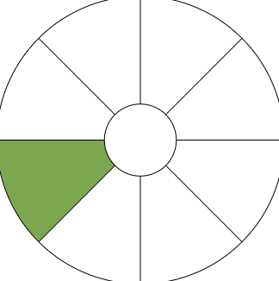
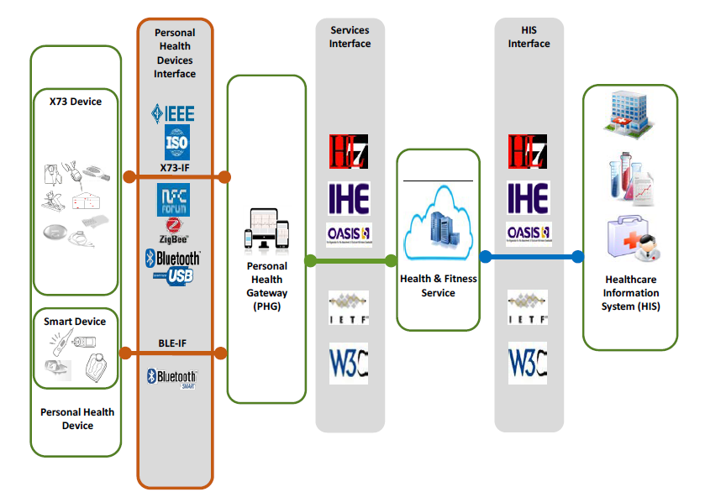
Fast Healthcare Interoperability Resources (FHIR) - an example
FHIR is a “universal translator” of health data
The connectivity and interfaces between personal health devices, services, and health information systems
Notes:
Image shows the flow of data - The increasing demand for accurate and efficient healthcare services highlights the importance of effective communication among diverse healthcare systems. Interoperability plays a critical role in delivering coordinated
patient care, enabling data sharing, and supporting informed decision-making processes.
By providing a flexible, extensible, and resource based standard, FHIR enables the seamless exchange of health- care information, which is crucial for delivering coordinated patient care, improving clinical decision-making, and reducing healthcare costs.
USA
In the USA - More than two-thirds of hospitals reported using a HL7® Fast Healthcare Interoperability Resource (FHIR®) API to enable patient access to data in 2022
Four in five hospitals used APIs to enable apps to write data to the EHR and read EHR data, respectively
HL7 is a not-for-profit, ANSI-accredited standards developing organization dedicated to providing a comprehensive framework and related standards for the exchange, integration, sharing, and retrieval of electronic health information that supports clinical practice and the management, delivery and evaluation of health services
ANSI accreditation refers to the recognition given by the American Natio nal Standards Institute (ANSI) to standards developers that adhere to ANSI’s requirements and oversight
The FHIR defines the “standards for healthcare data exchange, including how healthcare information can be shared between different computer systems regardless of the way it is stored”
FHIR makes it simple for patients to manage their care, even if they see multiple providers in different healthcare organizations and use multiple plans (multiple payers using multiple EHRs). By creating a unified, single personal patient health record that integrates data from different formats
FHIR standards deliver a complete view of patient information to improve overall care coordination and clinical decision support.
Ureshnie notes: data enters the system in varying forms and natures and the ppoint it enters requires that FHIR translates the language based on standards to ensure an nuderstandable standard language for a standard result eg. codes trnaltaed to age, patient numbers etc…..
FHIR describes
Data elements,
Messaging and document formats
Application programming interface (API) for exchanging electronic health records (EHRs) and electronic medical records (EMRs).
FHIR allows the developers to develop standardized browser applications that enable the user to access clinical data from any health care system regardless of the operating systems and devices that a health care system uses - https://www.ncbi.nlm.nih.gov/pmc/articles/PMC8367140/
With regard to health research, there is still a lack of use of international standards when exchanging data between healthcare and research institutions - https://www.ncbi.nlm.nih.gov/pmc/articles/PMC9346559/
Image: Different health devices and systems are interconnected.
Improving interoperability in healthcare.

Slide 25
Engagement sessions - The future of the digital ecosystem
What does cyber resilience look like in digital ecosystem of the future?
Notes:
The future of the digital eco-system….

Slide 26
1
The Fundamentals of data security in healthcare
2
Regulations and guidelines in the Digital Health Ecosystem
Data security Overview of data collection and processing Overview of data access privileges and responsibilities Healthcare data access Healthcare Data Collection & Processing Considerations Establishing your cyber security team - In-house vs outsourced considerations Establishing your cyber security team - Operating model considerations Interactive session for audience feedback on “how does your organisation compare in establishing a digital ecosystem”?
3
The operating environment
4
Regulatory requirements for healthcare data
5
Guidelines and principles for data compliance and protection in operations
6
Practical applications and examples for health data security

Slide 27
Healthcare data collection & processing
Processing
Vital interests
Lawfulness, Fairness and Transparency
Processed in a manner that ensures appropriate security
Confidentiality
Protect an interest which is essential for the life of the data subject or another natural person.
Preventing fraud
Purpose limitation
Consent
Collection
Specified, explicit and legitimate purposes.
Not further processed in a manner incompatible with those purposes
Given by data subjects for one or more specific purposes.
Make data subjects aware of their rights
Withdrawal of consent - any time
Data minimisation
Accuracy
Adequate, relevant and limited to what is necessary in relation to the purposes for which they are processed.
Accurate, kept up to date;
Inaccurately data to be erased or rectified without delay timeously.
Notes:
Consent
Purpose Limitation

Slide 28
Data access privileges and responsibilities
Data subject
Data controller
Data processor
They have the right to access their own personal data
They have access to personal health data as long as it is necessary for performing their tasks. They are responsible for the lawfull, fair, and transparent processing of personal data.
Processes personal data on behalf of the data controller. They cannot access/use the data for their own purposes.They can only process personal data based on the instructions of the data controller
Choosing an appropriate processor
Accountability
Processor contracts
Joint controller - Article 26
“Two or more controllers jointly determine the purposes and means of processing (Hospital and Research Organisation). Should in a transparent manner determine their respective responsibilities for compliance ensuring the of the rights of the data subject” This is either by arrangement or as determined by Union or Member State law.
Notes:
References
Data Subject , Access
Data Processor , Access
Data Controller, Access
Joint controllers

Slide 29
Healthcare data access
Purpose limitation
Data minimisation
Staff should only have access to the data that they need in order to complete their duties.
Staff level | Access
Doctors | Full access to patient’s health records for treatment purposes
Nurses | Access to relevant health information for patient care
Administrators/Support | Limited access
Smart Health App Developers | De-identified user data for app improvement
EHR Managers | Full access for system maintenance, but bound by confidentiality
Social Media Platforms | No access to personal health information
Notes:
The General Data Protection Regulation (GDPR) provides a framework for the processing of personal data, including health data. Here’s how it applies to different roles in a healthcare setting and what each role is typically not allowed to access:
Doctors: Doctors are considered data controllers under GDPR

Slide 30
Healthcare data collection & processing considerations
Small businesses
“The requirements around data processing records shall not apply to an organisation with less than 250 employees, unless:
The processing is likely to result in a “risk to the rights and freedoms of data subjects”
The processing is not occasional
The processing includes special categories of data
GDPR Article 30: Records of processing activities
Notes:
Small businesses

Slide 31
Establishing your cyber security team - In-house vs outsourced considerations
Cybersecurity teams in healthcare organisations play a critical role in safeguarding patient data and maintaining operational continuity, thereby ensuring the delivery of high quality care. Through collaboration with other areas of the business, the cyber security team ensures a holistic approach to security, addressing user education and technical solutions.
Considerations | Outsourced | In-House Team
Suitability | Small to medium sized organisation | Medium to large organisations
Control | Managed - Generally through SLAs. | High control
Costs | Managed - not as much flexibility around cost | High
Skills | Wide range available based on service agreement and training for cybersecurity awareness | Generally limited based on budget and availability
Setup time | Short | Long
Scalability | High | Fair
Decision making | Somewhat biased | Controlled
Key-person dependency risk | Internal organisational dependency is low | High

Slide 32
Establishing your cyber security team - Operating model considerations
Centralised
De-centralised
Hybrid/Distributed
Most often used by large enterprises and organisations with multiple locations in one country and/or worldwide.
Inherent risk of a single point of failure.
In this model, the organisation has dispersed security teams that manage risks often at the local or regional levels.
Often adopted by smaller organizations with a narrow physical footprint and less sophisticated risk operations.
The hybrid model combines elements of both approaches.
Core security functions (like governance, risk management) are centralised, while operational security (such as network monitoring or endpoint security) is decentralised.
Notes:
https://www.dataminr.com/resources/blog/centralized-vs-decentralized-security-operations-know-the-difference-and-which-to-adopt/

Slide 33
Engagement session
How does your organisation compare in establishing a digital ecosystem?
Global and regional partnerships
Digital skills and literacy
Finance incrementally
Focus first on interoperability
standards and certification
People-centered
Data governance
Solutions that prioritise
marginalised groups
Notes:
Whatever the future context my look like, certain aspects will always remain important
Reference
World Bank Reference
We’ll refer to this later in slide 90

Slide 34
1
The Fundamentals of data security in healthcare
2
Regulations and guidelines in the Digital Health Ecosystem
3
Data Compliance Covering principles relating to protection, security and exchange of healthcare data Health Data Security - Data Breach Notification procedure APAC Policy Maker recommendations
The operating environment
4
Regulatory requirements for healthcare data
5
Guidelines and principles for data compliance and protection in operations
6
Practical applications and examples for health data security

Slide 35
Healthcare data transfer
Data processing agreements
Data protection safeguards
There should be legally binding agreements with third parties for transfers that specify purpose, scope, and obligations.
Third parties should have adequate technical and organisational capacity to to protect the patient data (DPIA).
International data transfers
Patient notification and consent
International transfers (outside EEA) need to ensure that adequate safeguards to protect patient data (Implementing Act with Concessions).
Patients should be informed and explicit consent should be obtained clearly explaining nature and purpose of the transfer.
Transfer/ Exchange
Notes:
Transfer - 44
Recital 101
Adequacy
Implementation Act: - If the Commission decides that the level of protection is adequate, they issue an ‘implementing act’. This is a formal decision that allows data to be transferred to that third country, region, or organization
Periodic review: Every four years
Monitoring
Constantly monitor for any changes that could affect data protection.
If adequacy level changes then EU commission can repeal, amend or suspend the decision
Can enter into consultation to remedy the situation
Published list of countries with adequate third-country data protection (Official Journal of the European Union)
A transfer of personal data to a third country or an international organisation may take place where the Commission has decided that the third country, a territory or one or more specified sectors within that third country, or the international organisation in question ensures an adequate level of protection. Such a transfer shall not require any specific authorisation.
When assessing the adequacy:
the rule of law, respect for human rights and fundamental freedoms, relevant legislation, both general and sectoral, including concerning public security, defence, national security and criminal law and the access of public authorities to personal data, as well as the implementation of such legislation, data protection rules, professional rules and security measures, including rules for the onward transfer of personal data to another third country or international organisation which are complied with in that country or international organisation, case-law, as well as effective and enforceable data subject rights and effective administrative and judicial redress for the data subjects whose personal data are being transferred;
the existence and effective functioning of one or more independent supervisory authorities in the third country or to which an international organisation is subject, with responsibility for ensuring and enforcing compliance with the data protection rules, including adequate enforcement powers, for assisting and advising the data subjects in exercising their rights and for cooperation with the supervisory authorities of the Member States
the international commitments the third country or international organisation concerned has entered into, or other obligations arising from legally binding conventions or instruments as well as from its participation in multilateral or regional systems, in particular in relation to the protection of personal data.
Concessions
If there is no implementation act:
Controller or processor has provided appropriate safeguards
Enforceable data subject rights and effective legal remedies for data subjects are available - Data subjects have legal recourse
There should be
Legally Binding Instrument -
Binding corporate rules - Article 47
Standard Data Protection Clauses by the Commission - Article 93: EU Commission's standard contractual clauses for companies
Standard Data Protection Clauses by a Supervisory Authority - Article 93:
Approved Code of Conduct Article 40.
Approved Certification Mechanism Article 42: a cloud storage company in the US might obtain a certification that it meets European data protection standards
Data processing agreements
Data processing agreements: Healthcare organisations should have legally binding agreements in place with third parties, specifying the purpose, scope, and obligations related to the processing of patient data.
Data protection safeguards: Ensure that the third party has appropriate technical and organisational measures in place to protect patient data and comply with GDPR.
International data transfers: When transferring patient data outside the European Economic Area (EEA), healthcare organisations must ensure that adequate safeguards are in place. This can include using standard contractual clauses, obtaining explicit consent, or relying on approved certification mechanisms.
Patient notification and consent: Inform patients about the potential sharing of their data with third parties and obtain their explicit consent, providing them with sufficient information about the nature and purpose of the sharing

Slide 36
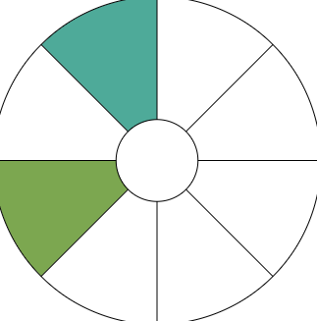
Health data security - Data breach notification procedure
Data breach
3. Notify relevant authorities
Report to the DPO
4. Analyse breach comprehensively
2. Assess the scope and impact
Low risk
High risk
After containing the personal data, review the remedial measures and their capacity to prevent reoccurence.
Monitor constantly to stay updated on cybersecurity risks
5. Remedial action
Notify patients/public communication

Slide 37
APAC policy maker recommendations
APAC report: Cross-border health data flow
Basic level of preparedness
“Address challenges of digitalising health data and legacy manual systems. Focussed approach on accelerating regulatory development aimed at addressing the nature of health data”
Intermediate level of preparedness
“Specifically target and consider health data within wider data sharing frameworks and policies. Consider creation of a national level body to be responsible for the governance of all health data use”
Advanced level of preparedness
“Leading and Supporting regional ambitions to influence and align with global frameworks as well as and striving for the addresal of interoperability challenges delaying global health systems digital maturity development”
Notes:
Reference
APAC HIMSS recommendations

Slide 38
1
The Fundamentals of data security in healthcare
2
Regulations and guidelines in the Digital Health Ecosystem
3
The operating environment
Interactive session for audience feedback on maturity self assessment, cybersecurity compliance and team roles and capacitation
4
Regulatory requirements for healthcare data
5
Guidelines and principles for data compliance and protection in operations
6
Practical applications and examples for health data security

Slide 39
Cyber-security preparedness based on breaches and threats
Case Study 1 - Multinational health insurance and services company
Case Study 2 - Non-profit healthcare provider
Ransomware attack in 2024.
Ransomware attack in 2021.
A staff member’s access credentials were stolen as the cyber criminals were able to gain system access through a portal that did not have multi-factor authentication (MFA) enabled.
Ransomware attack resulting in the loss of access to information systems and backup servers.
More than six terabytes of data, including "sensitive" medical records were affected.
The attack triggered a disruption of payment and claims processing. The affected doctor's offices and health care systems were unable to file claims and get paid.
Attack resulted in the suspension of IT systems and their public facing portals.
Other hospitals owned by the company had to turn away patients with specific patient needs.
Ransom amount of $22 million.
The impact on company earnings is estimated to be approximately $900 million.
Cost $112M in lost revenue and fines.
$21.1 million had to be spent on response and recovery.
Additional $3.5m lost in class action settlement.
Notes:
https://www.cbsnews.com/news/unitedhealth-senate-hearing-cyberattack-change-healthcare/
Case Study 2

Slide 40
Cyber-security preparedness based on breaches and threats
Case Study 3 - Personal genomics and biotechnology company
Case Study 4 - University medical centre
Data breach in 2023.
Denial-of-Service (DoS) attack in 2019-2020.
Initially, user accounts were accessed via user credentials (compromised passwords).
Credential stuffing then occurred with the data breach to access other accounts.
No MFA was present in a majority of cases.
An employee took a work laptop on vacation last fall and opened a personal email. The email contained malware, which was then installed on the employees work laptop.
The attackers after gaining access to broader systems, encrypted hospital files and loaded malware onto more than 5,000 computers.
The data included certain basic personal information such as a display name, gender, birth year, and some details about genetic ancestry results.
Approximately 7 million user profiles were compromised. The hackers have attempted to sell user data for varying amounts.
EMRs were inaccessible for 28 days and all services reverted to paper-based forms of capture.
Patient care was disrupted, the provision of cancer was significantly disrupted.
Total financial costs of approximately $65 million.
Cancer care impact was approximately $30 million.
Significant brand and reputational damage.
Notes:
https://www.sevendaysvt.com/news/ukrainian-man-pleads-guilty-to-uvm-medical-center-cyberattack-40246445
https://vtdigger.org/2021/07/21/malware-on-employees-company-computer-led-to-cyber-attack-on-uvm-medical-center/
https://www.vermontpublic.org/local-news/2023-10-04/uvm-medical-center-hospital-president-testifies-to-congress-on-2020-cyberattack

Slide 41
Feedback, Q&A and Closing Remarks
Notes:
Menti
How many are using which one ?
Where are they on their own scale ?

